Slide 1
Family & Community
Engagement
Advisory
Council
FEAC
EVERETT PUBLIC SCHOOLS
March 5, 2024
WELCOME

Slide 2
Land Acknowledgement
We respectfully acknowledge that we are on the traditional lands of the Coast Salish, Snohomish and Tulalip Peoples, as we begin to heal. Everett Public Schools is committed to improving the relationship and identifying indigenous people, exploring our true selves. We express our deepest respect and gratitude to the ancestors of this land. We strive to create equitable outcomes and build a culture of inclusive belonging for all students, teachers, staff and community.
Land Acknowledgement
Notes:
Anne

Slide 3
Agenda
6:00 – 6:05 Welcome and Opening Comments
Chris Fulford
6:05 – 6:45 Learning – Transitions and CTE
Anthony Anderson
Dave Peters
6:45 – 7:15 Discussion and Feedback
Advisory Council Team
7:15 – 7:25 Next Steps and Agenda Setting
Chris Fulford
7:25 – 7:30 Closing
Chris Fulford
Agenda

Slide 4
Norms of Collaboration
Stay engaged​
Expect to experience discomfort at some level​
Paying attention to self and others​
Be aware of intent: Own your impact​
Keep focused on our collective goal​
Speak your truth​
Maintain a learner stance and remain open to new thinking​
Pursuing a balance between advocacy and inquiry

Slide 5
Priority Student Outcomes
Notes:
Chris

Slide 6
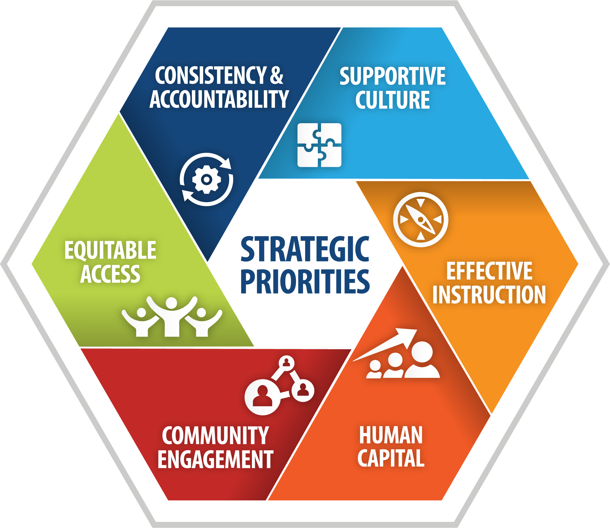
Priority Student Outcomes
Notes:
Chris

Slide 7
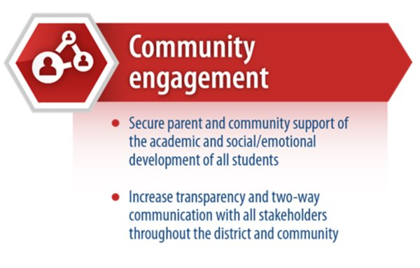
Strategic Theme
Notes:
Jeanne

Slide 8
CTE And Choice Programs
Feedback
Elementary to Middle &
Middle to High School Transitions

Slide 9
8th-HS Transitions
Pre-Registration
FEAC | March 5, 2024

Slide 10
8th–HS Grade Transition Meetings

Slide 11
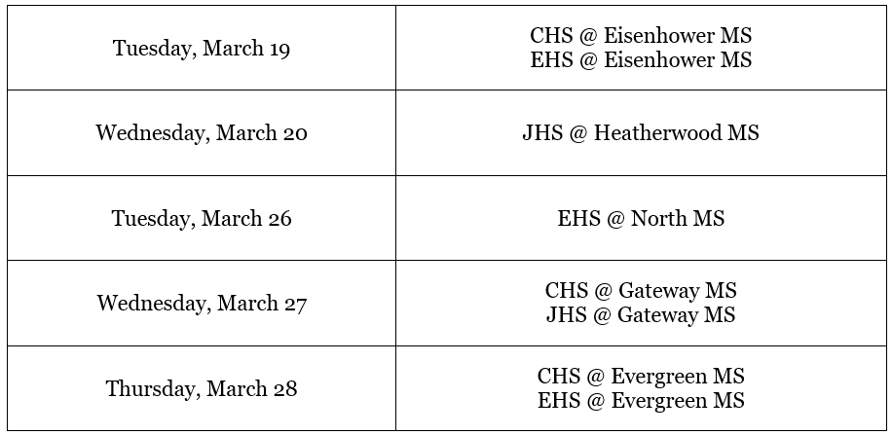
8th–HS Grade Transition Meetings

Slide 12
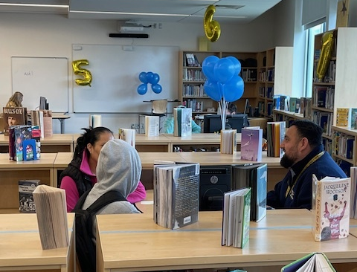
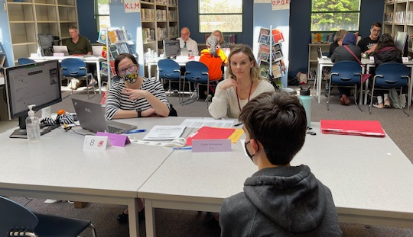
8th Grade Transition Meetings

Slide 13
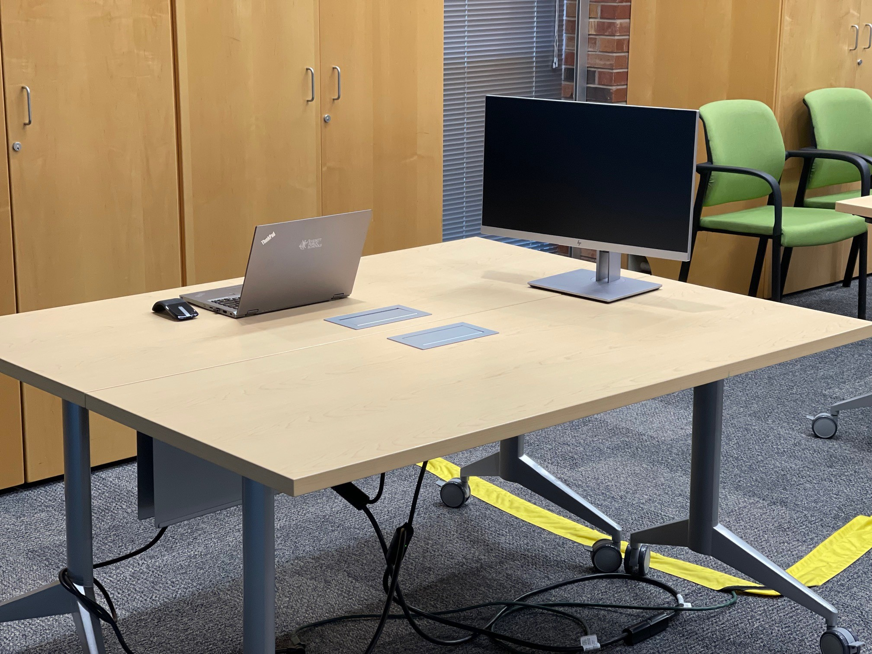
Tech Considerations
Monitors and cables will be delivered and setup by the field tech team @ each MS
Electrical power for the monitors and laptops will be addressed by Maintenance

Slide 14
Ideas for Virtual Access (optional)
Designated area for table(s) to host a Zoom for families who prefer to attend virtually
Each table is assigned a Zoom link, and families attend virtually

Slide 15
Student Data

Slide 16
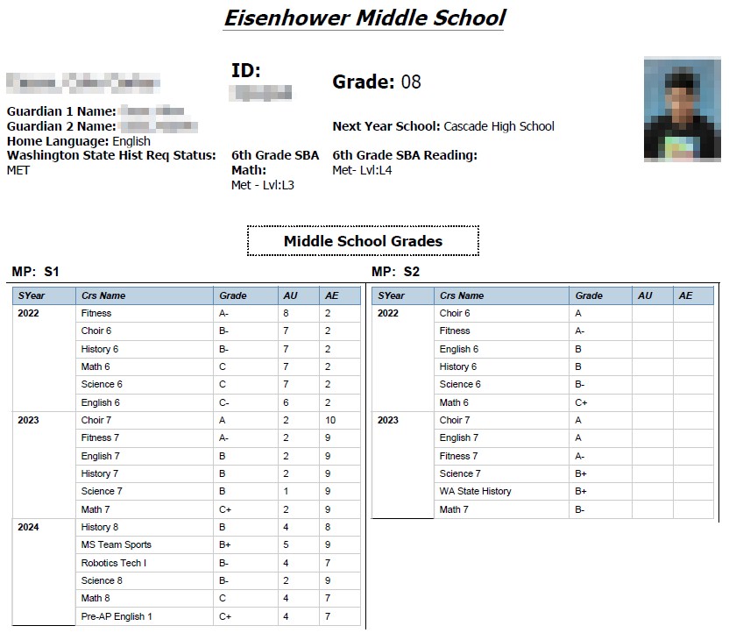
Student Data

Slide 27
Discussion
What is your lived experience with school transitions (i.e. elementary to middle school and middle to high school)?
What is your lived experience with CTE?
What would make these transitions and programs more accessible for all families?
What can we improve now (immediate changes before the end of summer)?
What can be improved for next year?

Slide 28
Thank You!

